Slide 1

SIGMA
DEEP PANCHANI
BHARTI VASWANI

Slide 2
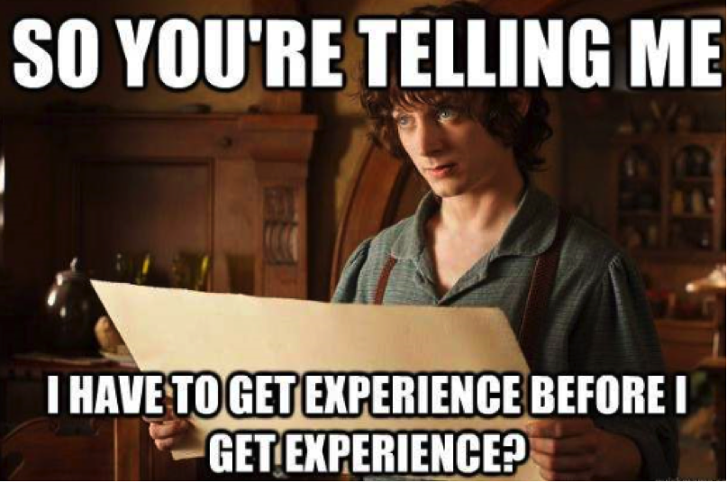

Slide 3
Problem Statement
It’s hard to start freelancing and getting experience as a beginner as a result of which people get confused.
So, wanted to help newbie to get freelancing project and experience at one platform.

Slide 4
Target audience
Mainly the people who are new to the field have skills but lack in experience.
So, to get them specialized in there preference of domain by experience.

Slide 5
Proposed solution
As we know it's a fast-growing world and everyday their are new things to learn. But in this competitive world the people who are new in the field are suffering. So, to overcome this we will create a platform where people with less experience can come and get open-source projects or can collaborate with each other to make projects.
For e.g., if someone is making an app but doesn’t have knowledge of UI. Then they can find someone on the platform who wants to do UI work for their app.
After they have made few projects and qualified quiz round they will be certified on the basis of their work. We will also have a place where people can contact each other and discuss their projects, collaborate or even ask doubts and do iterations on their work.

Slide 6
Competitor analysis
The main competitor of this idea are pre existing freelancing sites, as they are well established in freelancing industry.
And sites like edx.org and coursera which provide certification from highly reputed colleges and companies, but they lack in giving real life experience.
Stack overflow and Quora will also become one of the main indirect competitor as it has a huge user base, but we have make sure our community app will give a better user experience.

Slide 7
USP
Its open source.
One of its kind.
Its freeware and made user centric rather than profit making.
Community App- where people can connect and work on their projects.
We will give them practical knowledge before they even get in to market.
Online certification.

Slide 8
Working
The user will visit to our site and learn from our free content. And get the free certification on basis of their ONLINE TEST. And we will also give a an option to get project review certification but it will be paid (with nominal charges).
We also have community app where they can collaborate with people round the world. And make new projects with them. Its interface will be just like any other messenger app.
We will give them free hosting for portfolios, their projects and resumes.
They can search for jobs on the basis of their projects and knowledge.

Slide 9
Application
The free content for certifications will be updated regularly to give the current market knowledge which others lack in. We will hire experts to rate their projects for certification and AI based model to make question paper.
Community app will work like any other messenger app plus we will also have a web version for it so that people can access it from anywhere.
For hosting space we will require servers and high speed internet connection.
And at last an AI based job suggestion software to give the user best suitable job according to their knowledge and skill set.

Slide 10
Finances
Overall it is a non-profitable organization for freelancers by freelancers. Investments are hiring specialized people of fields to whom people can connect and get help from them, people who would be handling the queries and the community app.
Revenue generation through advertisement, premium hosting plans, certification charge, share the money earn through paid jobs.
Burn rate as the investment is limited so whatever our organization get as profit will again be reused it for development of website.

Slide 11
Tech Stack
Webhosting- For initial stages
Internet connection
AI- For research work
Man power

Slide 12
Conclusion
To conclude we would say that it will be a platform to help newcomers in the industry. It will help them gain technical skills along with soft skills.
With a valid certification to showcase their knowledge and hard work. Plus doing projects will give them real life experience which will help them during freelancing.
So that they get an easy breakthrough in the industry.

Slide 13
Thank you

